Slide 1


Notes:
Thank you again for carving time out of your busy schedules
You are all critical to the future of Scouting and we're honored to play a role in partnering with you to be helpful and supportive
Before I hand it over to Mike, this is a day to take about where we’re at, where we're going, and how we can best serve you
This is meant to be a time for you to talk and share so please chime in at any time

Slide 2

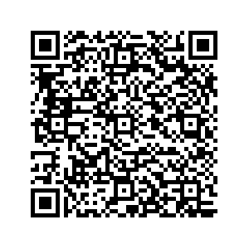

Scout Fundraising
Sign Up Now!
Notes:
Include family planner (from IYOS scope sheet)

Slide 3
Ideal Year of Scouting
Scout Fundraising
Plan Program
List activities & adventures
Hold a brainstorming session with families
Add a new trip or campout for excitement.
Budget
Use TE budget tool to assign costs and expenses.
Add in camp, registration fees, advancements & Unit dues.
Calendar
Provide a monthly calendar of activities so families are aware of the fun.
Set Goals
Total Program Costs ÷ Unit Commission = Unit Sales Goal.
Divide Unit goal by # of Scouts to get Scout goals.
Raise the Money
Commit to achieving the Unit’s goal with one fundraiser.
Less time fundraising = more time Scouting!
Enjoy the Year!
Notes:
Include family planner (from IYOS scope sheet)

Slide 4
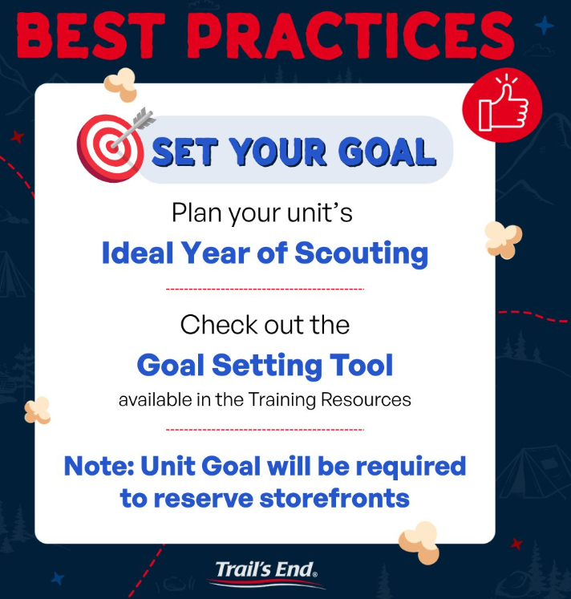
Scout Fundraising
Notes:
Include family planner (from IYOS scope sheet)

Slide 5



Ways to Sell
Scout Fundraising
Storefronts
Setup tables at high foot traffic locations.
Scouts sell to customers coming in and out of stores.
Best Practice: One Scout and their parent per shift.
Wagon
Sell door-to-door
Best Practice: Bring product with you to avoid second trip to deliver.
Scouts can record undelivered orders in App.
Online
Sell virtually to family and friends by sharing your online fundraising page via social, email & text.
Product ships to the customer.
Safest way to sell!

Slide 6
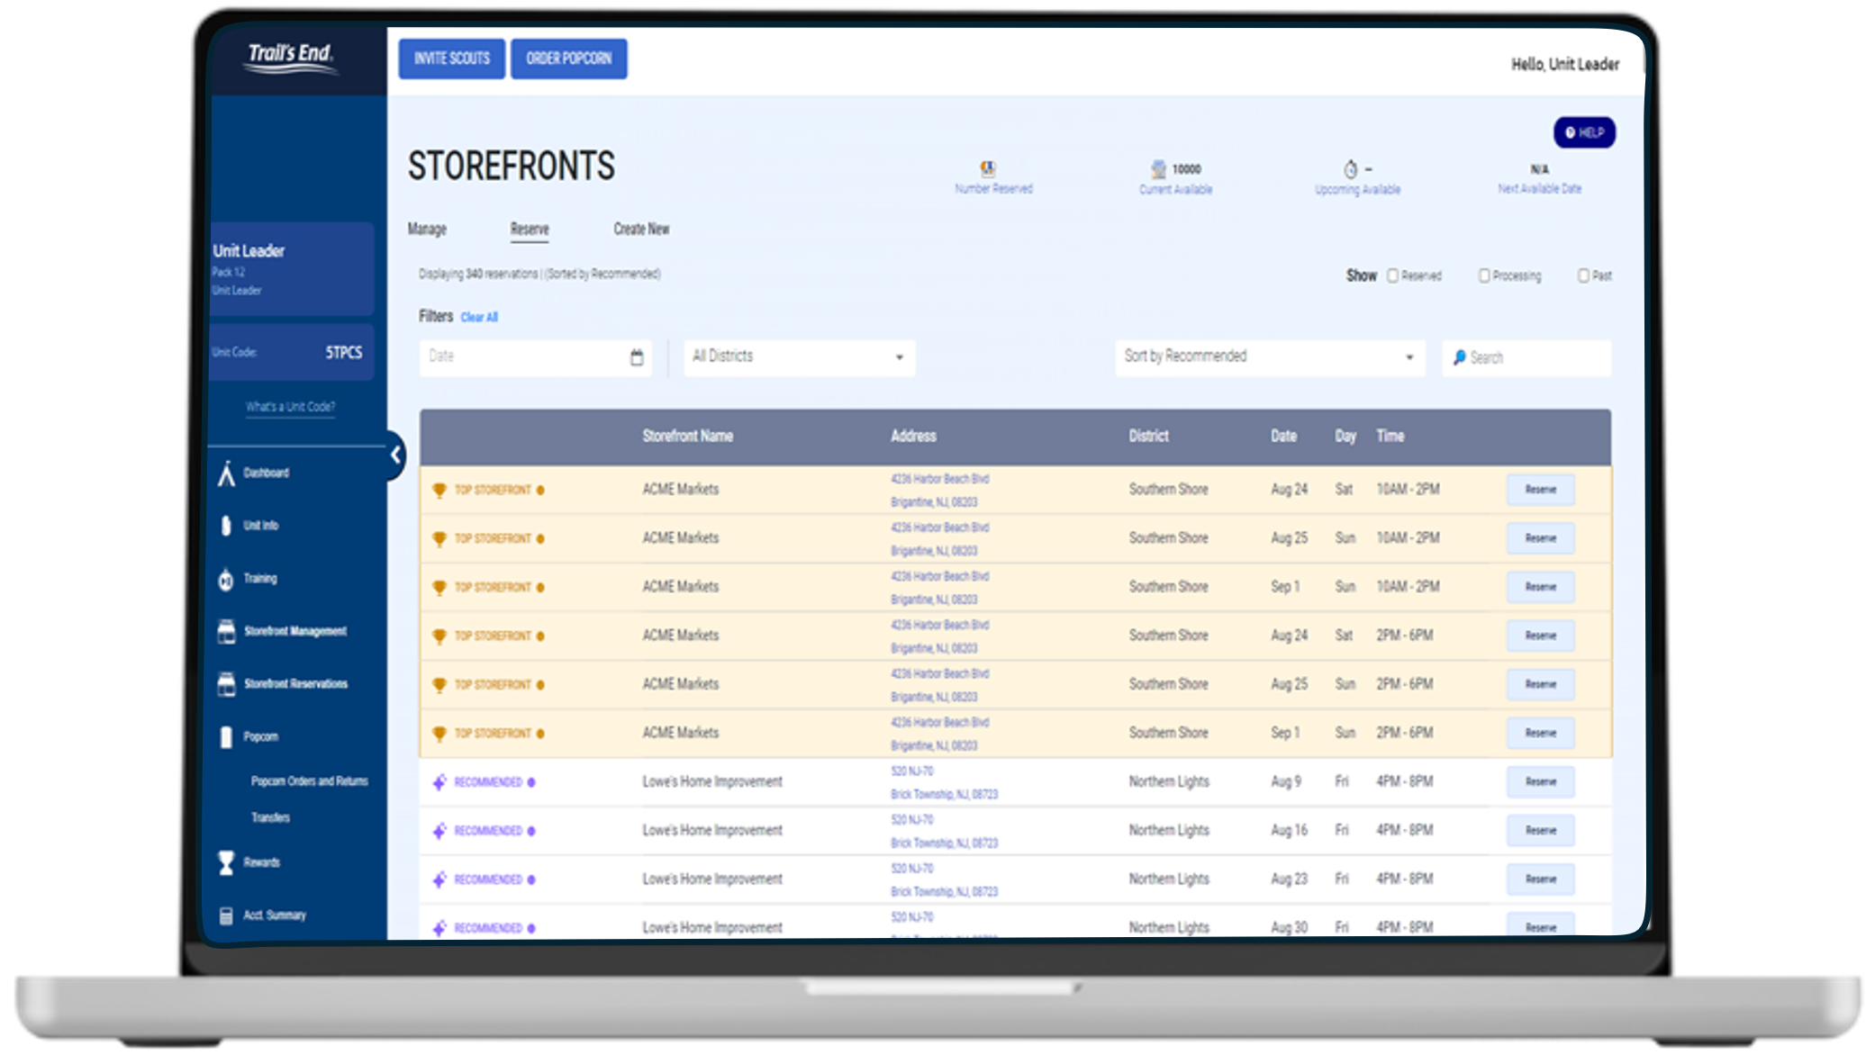
Trail’s End technology
Unit portal
Leaders manage entire sale in one place
Invite Scouts to register and manage Scout roster
​Easily set Unit and Scout goals
Order popcorn
Real time reporting of sales and inventory
Unit to unit transfers; no Council assistance needed
Schedule and manage storefront sites and shifts
Notes:
The app isn’t just for selling, Scouts can earn rewards and see their progress in the app as they sell
And We’re thrilled to offer more gift card options for 2025.
Scouts can choose giftcards for Walmart, Target, Cabela’s, REI, or a Mastercard gift card. Amazon is still available too.
With all these choices, Scouts can even split their rewards between more than one gift card, choosing the options that really excite them
It’s easy to claim their rewards and Scouts are guided through the entire process

Slide 7
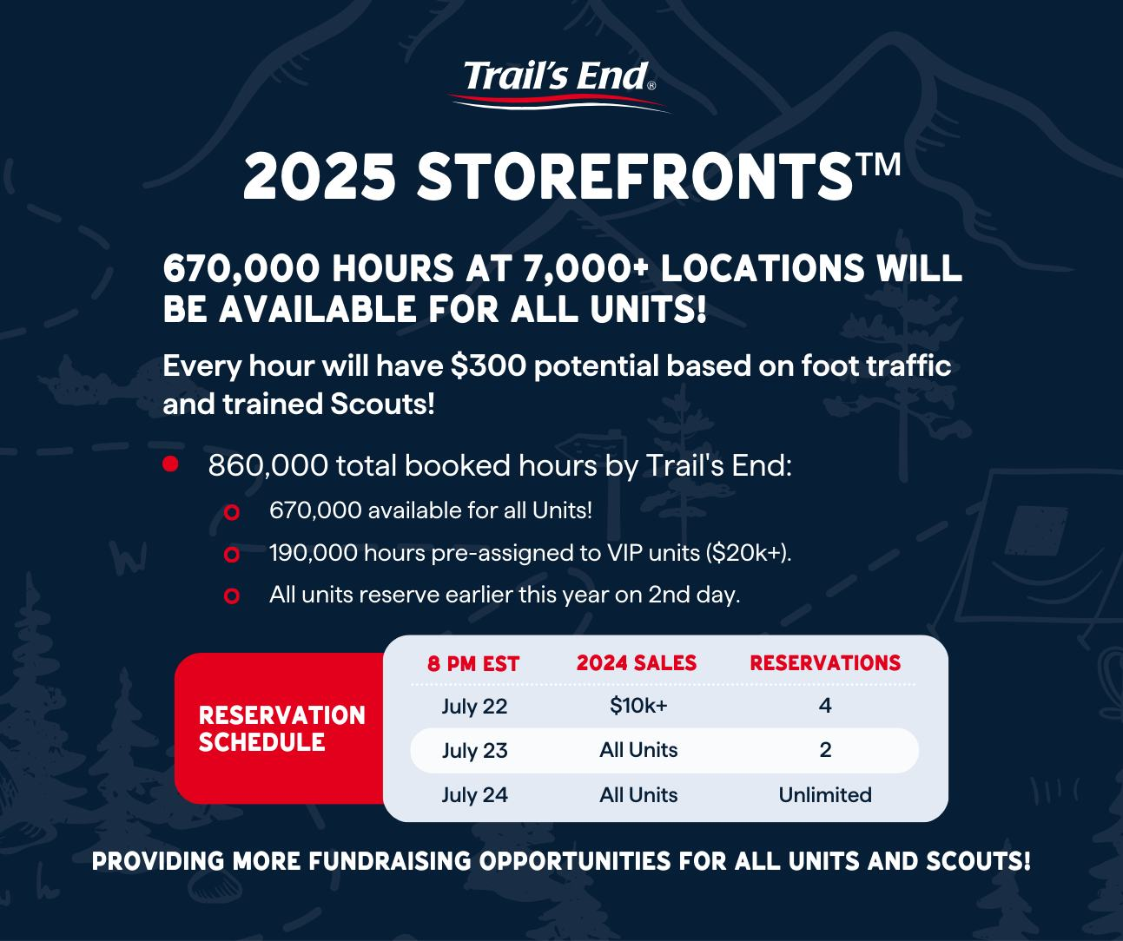

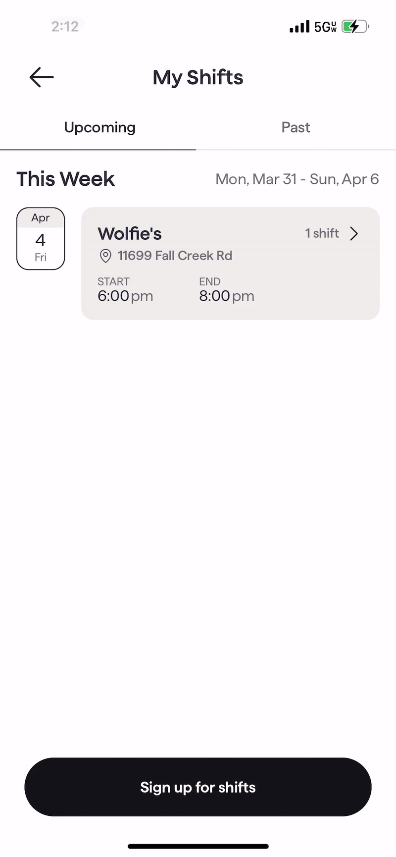
Notes:
The app isn’t just for selling, Scouts can earn rewards and see their progress in the app as they sell
And We’re thrilled to offer more gift card options for 2025.
Scouts can choose giftcards for Walmart, Target, Cabela’s, REI, or a Mastercard gift card. Amazon is still available too.
With all these choices, Scouts can even split their rewards between more than one gift card, choosing the options that really excite them
It’s easy to claim their rewards and Scouts are guided through the entire process

Slide 8

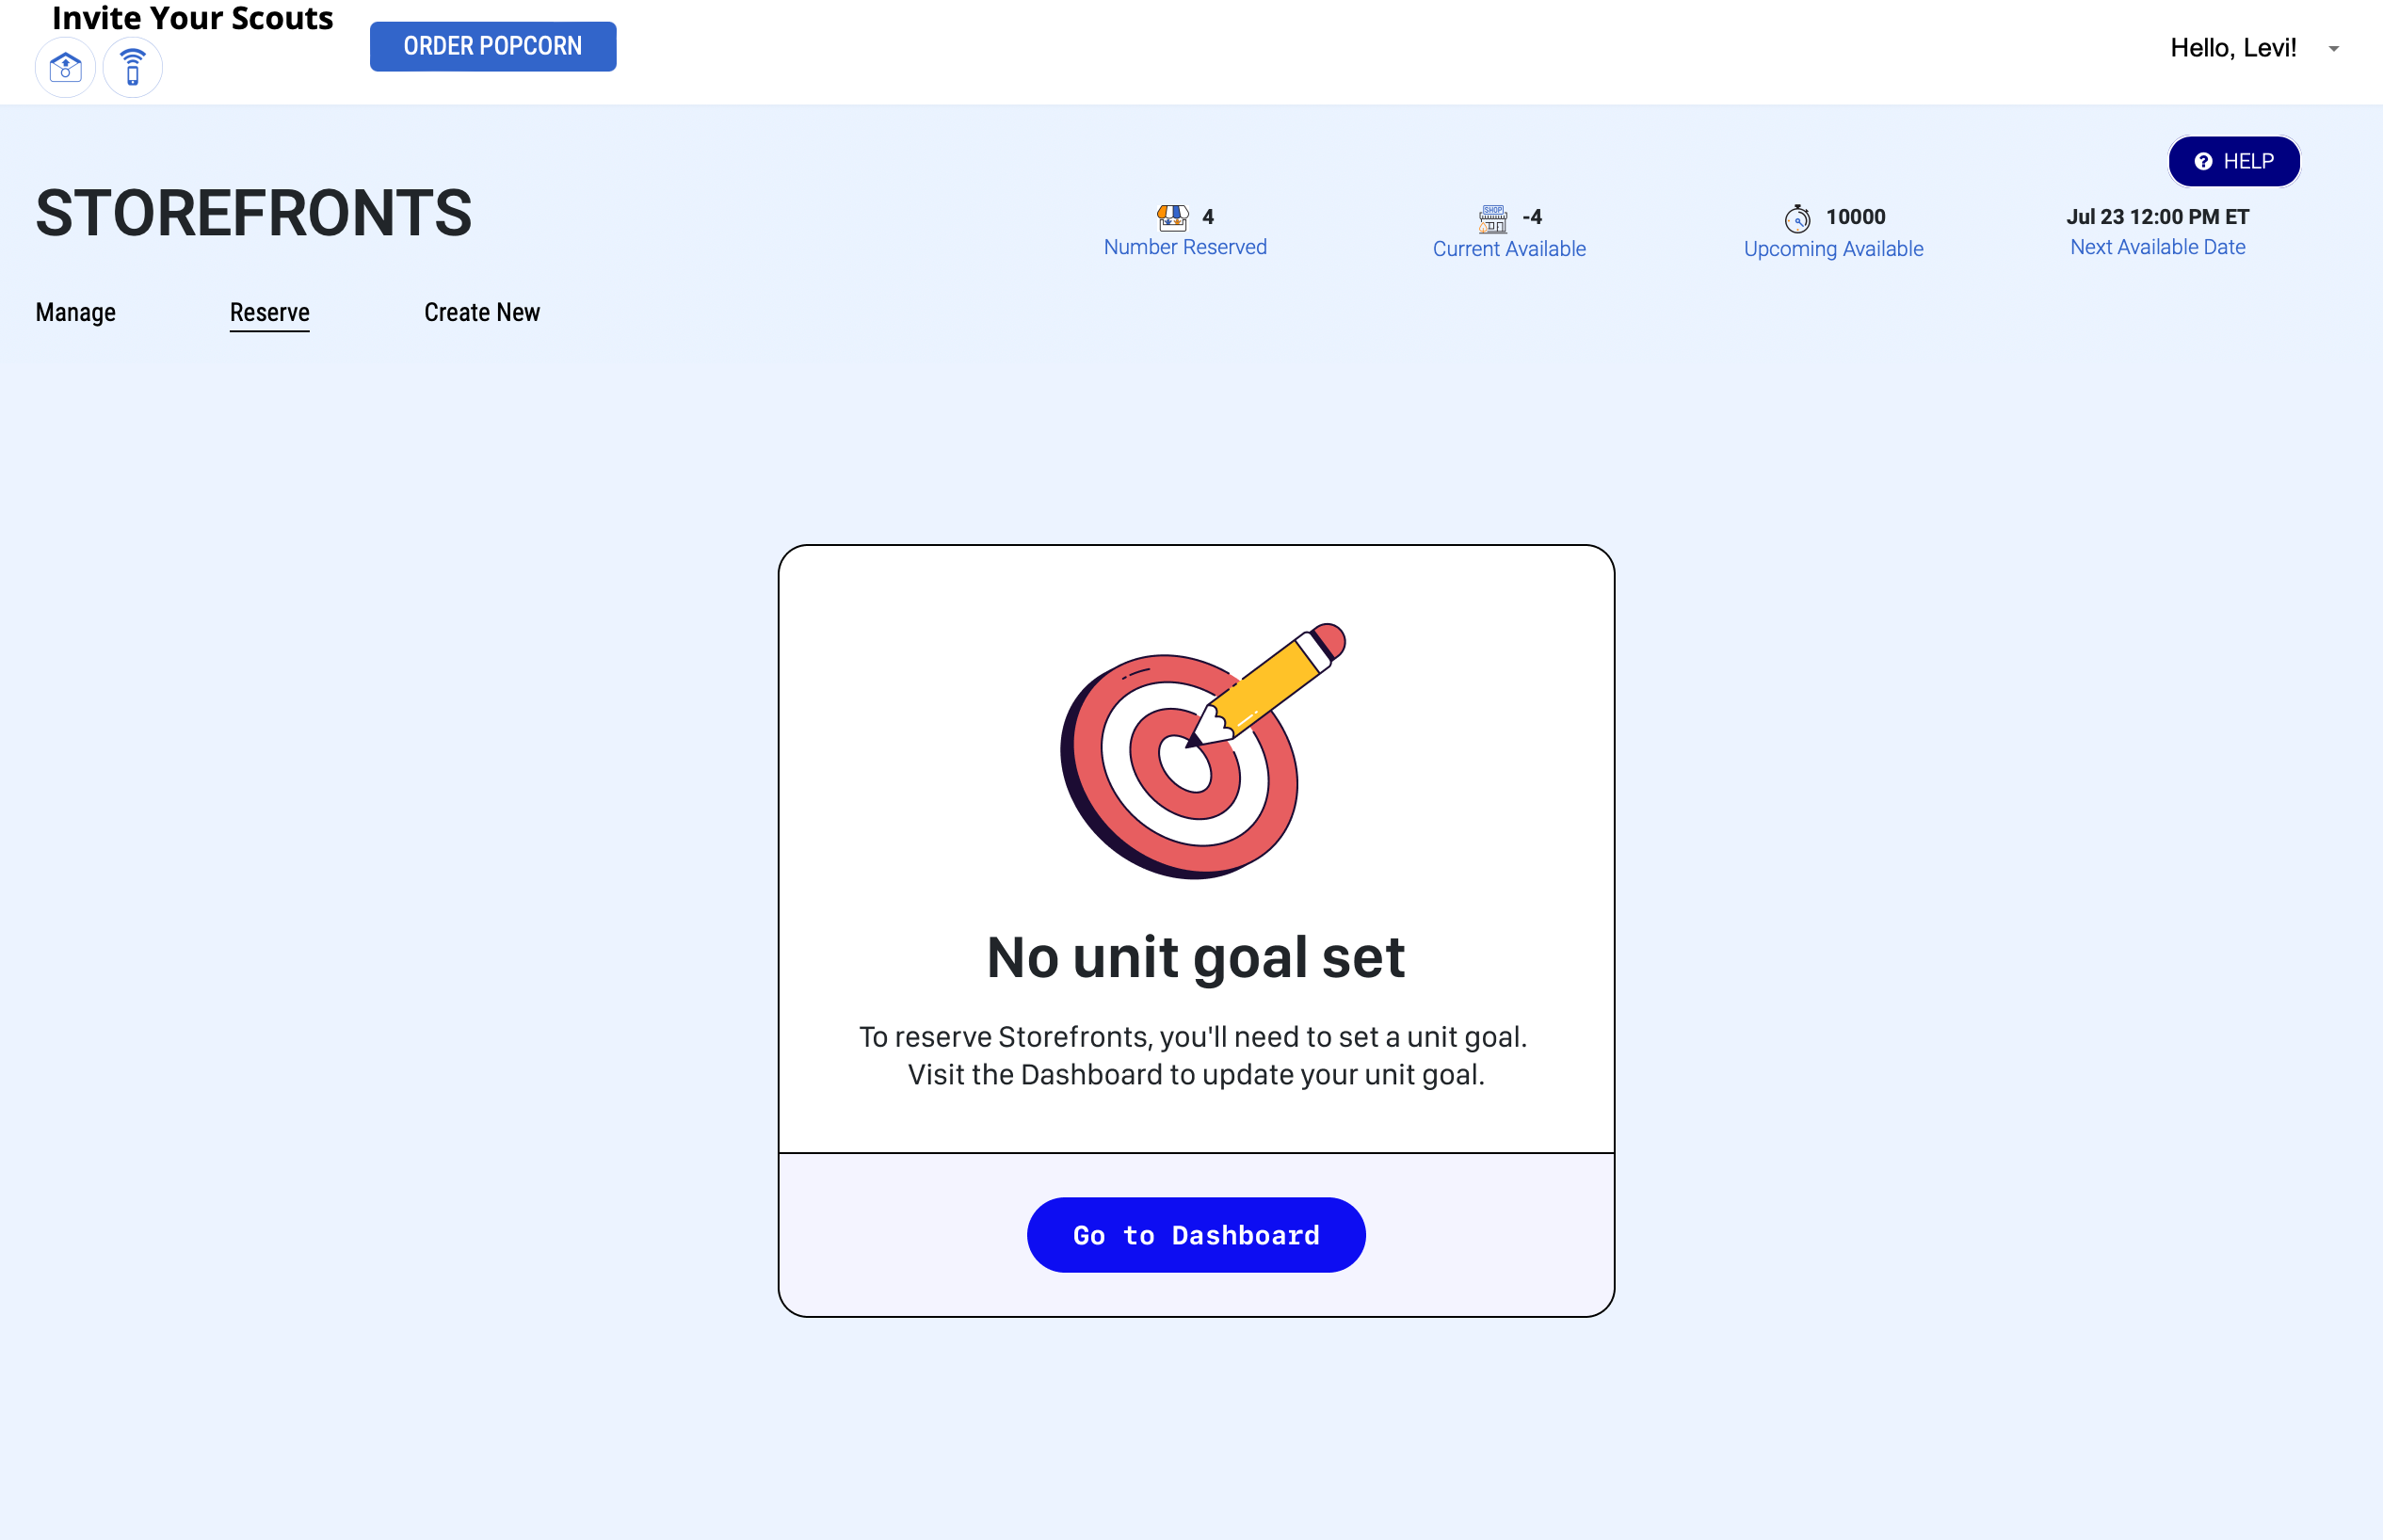
STOREFRONT EFFICIENCY
Updated reservation time – 8 pm (ET)
Goal required to reserve storefronts
Guidance on storefront hours needed to reach goal
Auto-release on Thursdays at 8 pm (ET) for Fri - Sun reservations
38% of weekend hours were claimed in 2024 and not used by Scouts

Slide 9
More opportunities for you to secure locations!
Shifts with 0 Scouts for the upcoming weekend will be released on Thursday at 8pm for everyone to claim.
Too many shifts were “no showed” in 2024 – this will help!

Slide 10
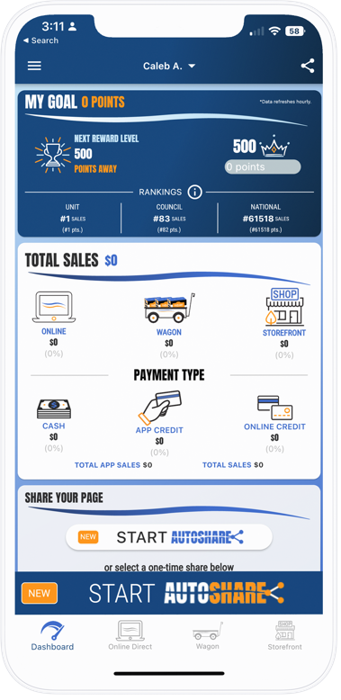

Trail’s End technology
Scout app
Point of Sale System
Saves time and easy to use
Google Play & Apple App Store​
Tracks real-time Scout sales/inventory
Manages storefront shifts
Accepts credit cards (85%+) and cash
All CC Fees paid by TE​
Tap to pay directly through phone
Notes:
The app isn’t just for selling, Scouts can earn rewards and see their progress in the app as they sell
And We’re thrilled to offer more gift card options for 2025.
Scouts can choose giftcards for Walmart, Target, Cabela’s, REI, or a Mastercard gift card. Amazon is still available too.
With all these choices, Scouts can even split their rewards between more than one gift card, choosing the options that really excite them
It’s easy to claim their rewards and Scouts are guided through the entire process

Slide 11
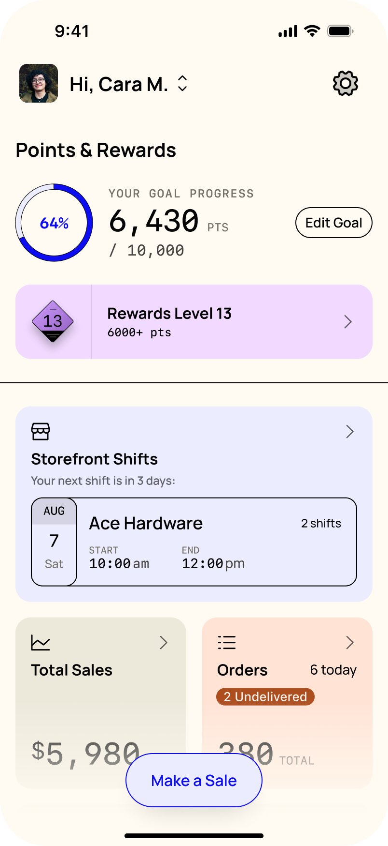
Trail’s End App
DASHBOARD
Single screen for all key actions:
Make a sale
Goal and rewards
Cash to Credit
Storefronts
Sales data
Orders
Online sales
Training

Slide 12
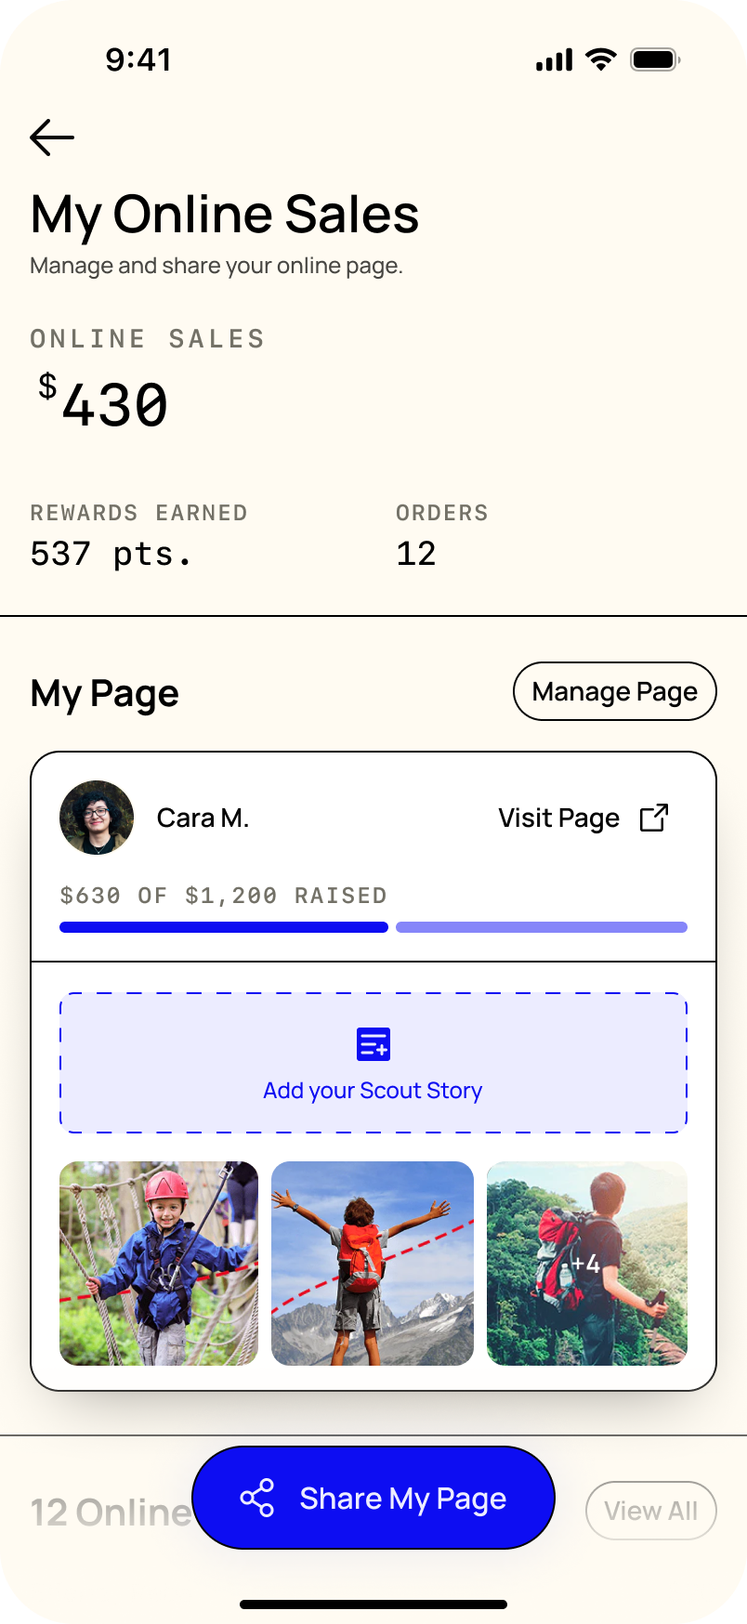
Trail’s End App
ONLINE SALES
Share is the primary action for Scouts
Past customers
Text
Email
Social
Scouts are guided to personalize their page with new empty states to help them get started

Slide 13
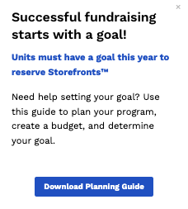
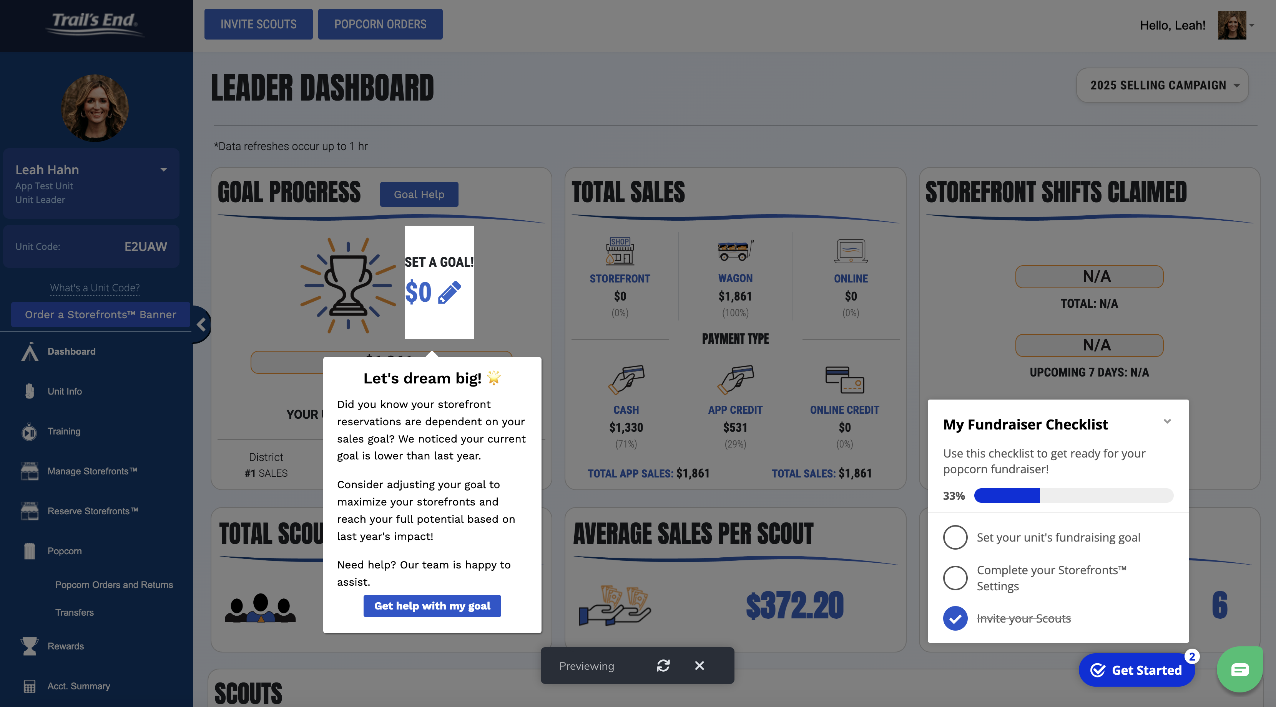
IN-APP GUIDES
232 users
Goal avg. $19,196
570+ completed
1700 units with a goal
Notes:
Was over $4000 below their last years sales, now increased goal by $1500 over last year’s sales

Slide 14
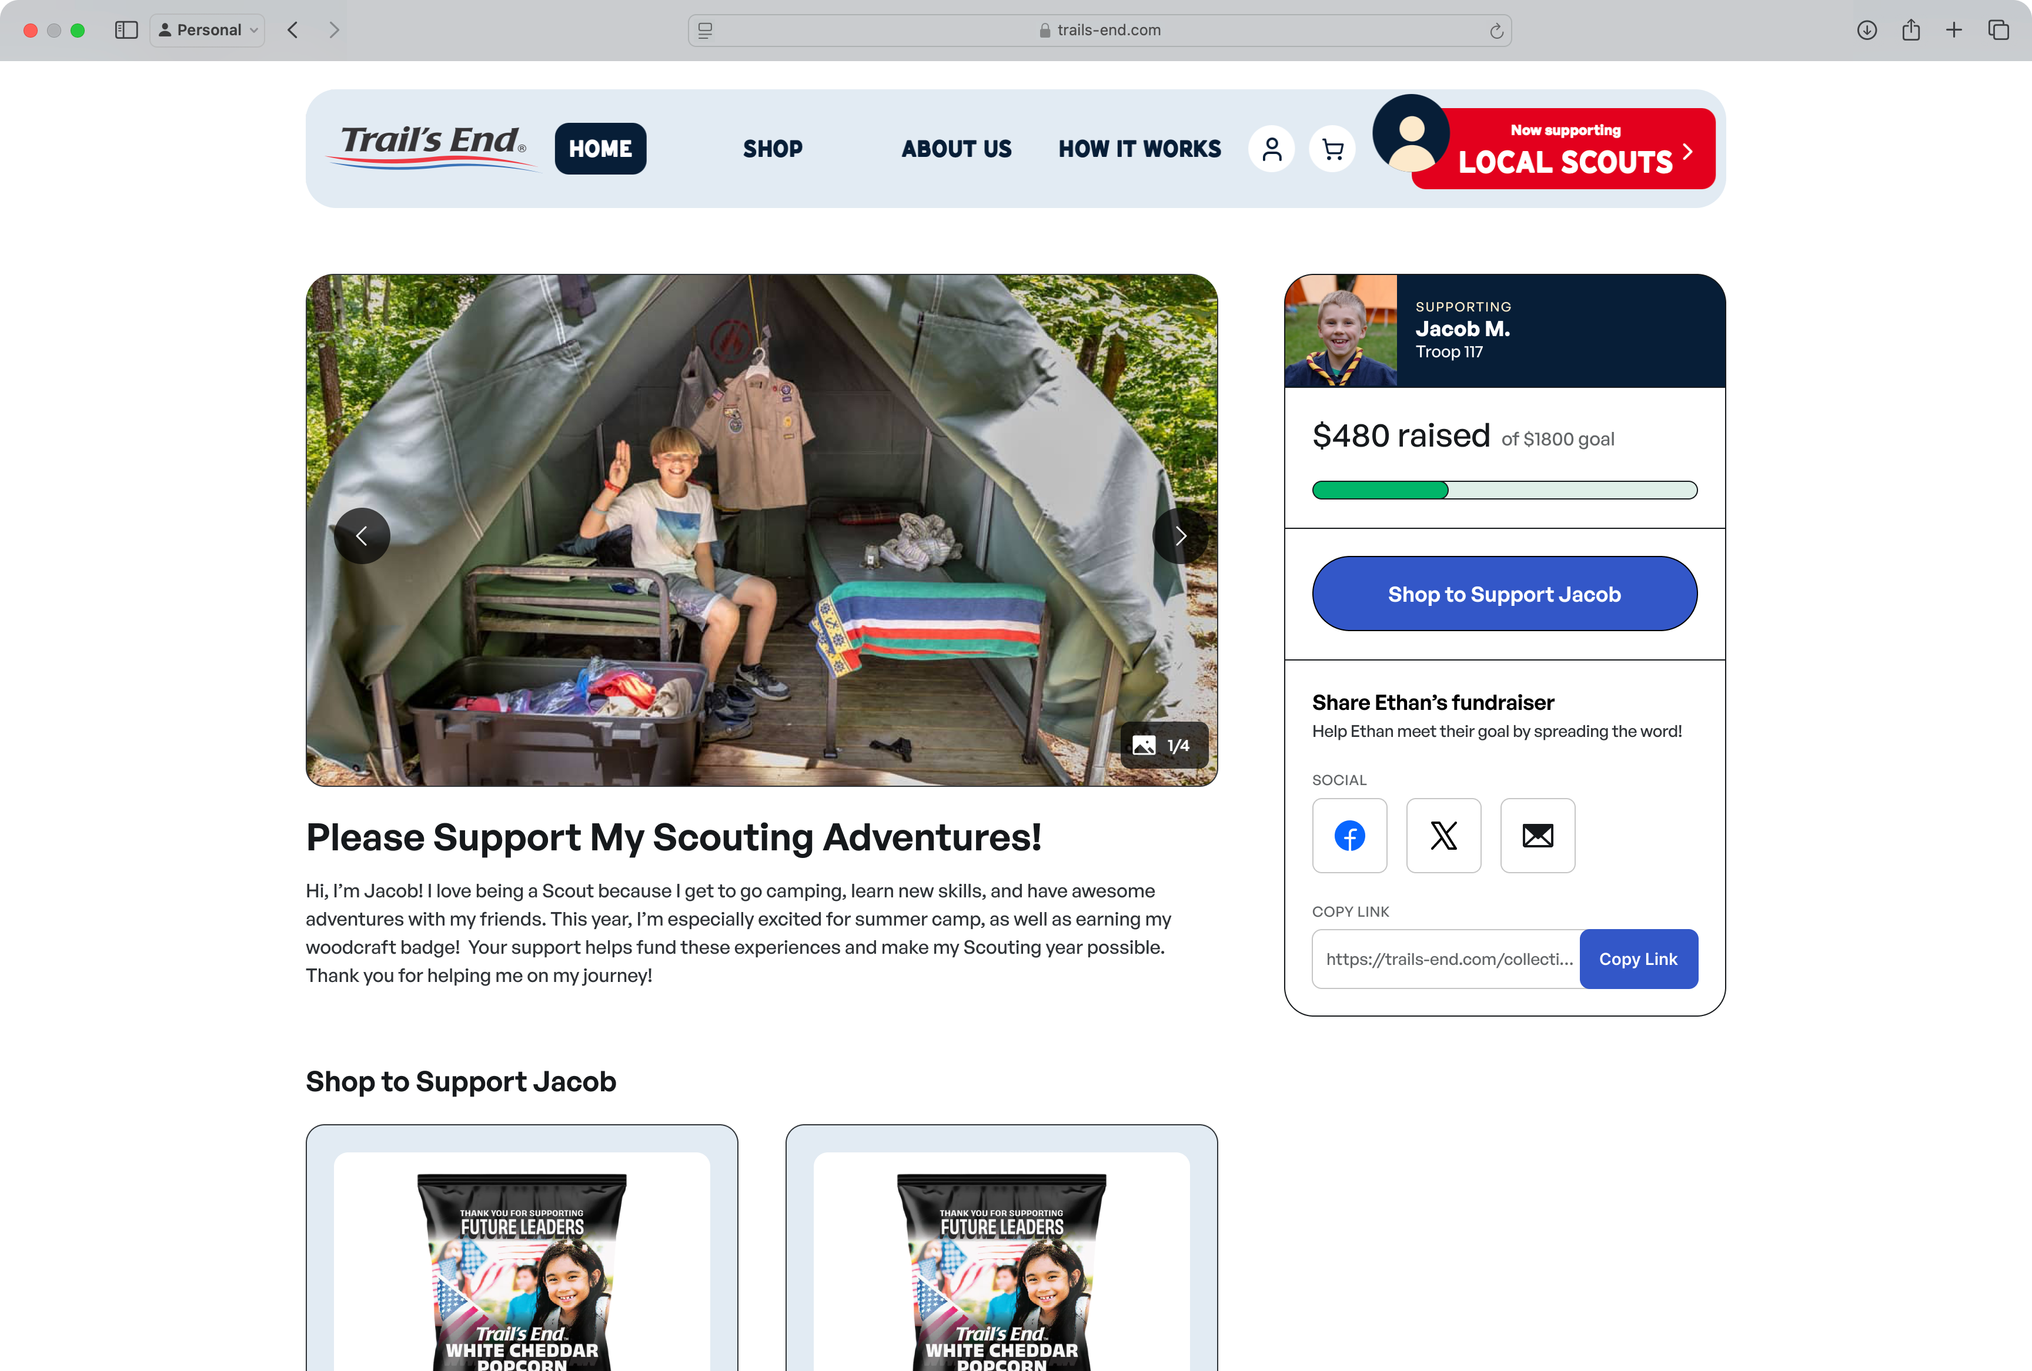
TRAIL’S END ONLINE
Redesigned Scout pages that:
Emphasize the Scout and their story
Allow consumers to share the Scout’s pages with their network

Slide 15
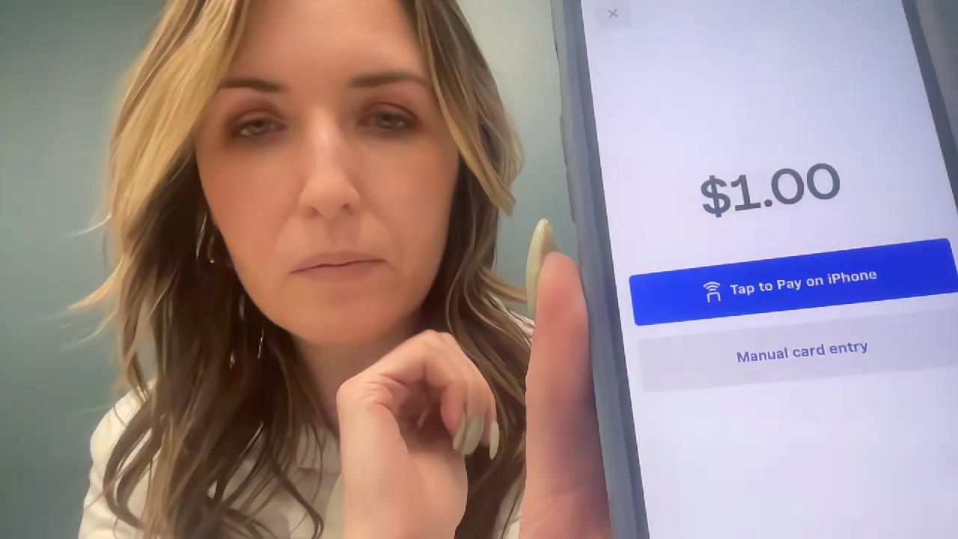
Trail’s End technology
Tap to pay demo
Notes:
The

Slide 16















AMAZON
TARGET
WALMART
PREPAID MASTERCARD
DICK’S SPORTING GOODS
NINTENDO
GAMESTOP
BASS PRO SHOPS
CABELA’S
APPLE
LEGO
XBOX
PLAYSTATION
Trail’s End App
Scout Rewards
Balance: 100.00
Scouts claim their rewards from the app
15 gift card options
Scouts can split their rewards across multiple gift cards
No approving, receiving, distributing, or replacing prizes.
Uncapped levels to incentivize top sellers.
Heroes and helpers bonus points! +.5 pts!
Notes:
The app isn’t just for selling, Scouts can earn rewards and see their progress in the app as they sell
And We’re thrilled to offer more gift card options for 2025.
Scouts can choose giftcards for Walmart, Target, Cabela’s, REI, or a Mastercard gift card. Amazon is still available too.
With all these choices, Scouts can even split their rewards between more than one gift card, choosing the options that really excite them
It’s easy to claim their rewards and Scouts are guided through the entire process

Slide 17



Header
PRODUCTS and Pricing
Scout Fundraising
REMEMBER – YOU ARE NOT SELLING POPCORN. ANYONE CAN GO INTO A GROCERY STORE AND BUY A BAG!
Change your mindset to “with a $20 donation you will be helping me attend *insert adventure like Jamboree / specific summer camp!” and pick anything from the table!
NEVER, NEVER, NEVER ask customers to buy popcorn. It’s to support You!
Even if the customer says no, always say, “Thank you” and “Have a good day.”
Notes:
Parent Pay Now & Heroes & Helpers

Slide 18
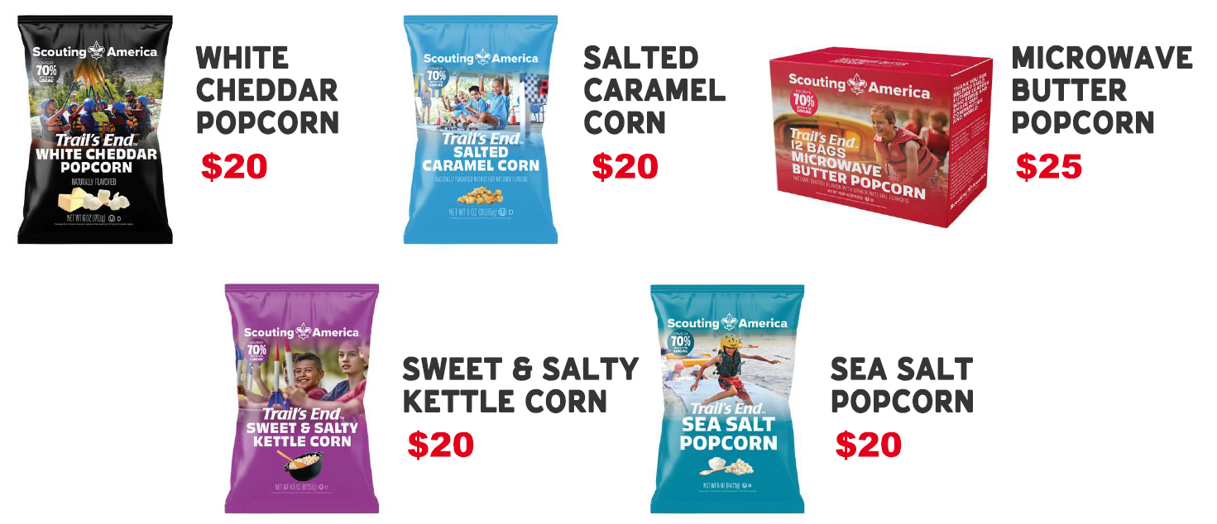
Header
PRODUCTS and Pricing
Scout Fundraising
Notes:
Parent Pay Now & Heroes & Helpers

Slide 19
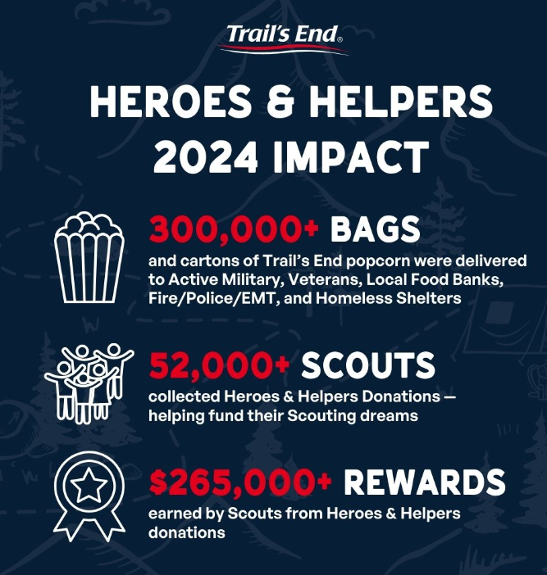
Any $ donation should be turned into the heroes and helpers program!
Scouts earn an additional 0.5 points per donation!
$1 credit card donation = 1.75 pts!
$1 cash donation = 1.5 pts!

Slide 20
Header
Council Sale Details
Scout Fundraising
Dates
August 5 – Popcorn Training Zoom
August 8 – First Orders Due
August 23 – First Distribuiton
August 29 – Popcorn Training Zoom & Switch 1 Orders Due
September 6 – Switch 1
September 12 – Switch 2 Orders Due
September 20 – Switch 2
September 26 – Switch 3 Orders Due
October 4 – Switch 3
October 10 – Switch 4 Orders Due
October 18 – Switch 4
November 1 – Final Returns and Orders Due
November 15 – Final Pickups
December 5 Final Popcorn Payments Due
***Orders not placed by due date cannot be guaranteed***
Pickup
Corrigan Moving Systems 740 Commonwealth Dr. Warrendale, PA 15086
Spin-To-Win
December 7 Location TBA

Slide 21
2025 Commission
Scout Fundraising
Base Commission = 30%
Additional 2%: Complete a show and sell
Additional 1%: Participate in an online and/or door-to-door Sale
Additional 3%: Increase your sales by 10% over 2024
(Must have sold in 2024)
Special Reward: Earn 40% Commission if you sell over $40,000. This overrides all other increases
Online Sales Commissions = 30%

Slide 22
Support
Scout Fundraising
District Executives
Anawanna Trails – Drew Manko – (412) 325-7960
Beaver Valley – Ken Smith – (412) 325-7966
Chestnut Ridge – Michael Cidor – (814) 860-1562
Eagle Valley – Nicholas Aubitz – (412) 325-7976
Forbes Trail – Michael Cidor – (814) 860-1562
Fort Bedford – Michael Cidor - (814) 860-1562
Frontier – Ken Smith – (412) 325-7966
Japeechen – Justin Schmiedel – (412) 325-7967
Keystone – Michael Cidor – (814) 860-1562
Lackawanna – Derek Riley – (412) 325-7981
Potomac – Andy Mackert – (301) 729-1300 x7152
Seneca – Gregory Talbert – (412) 325-7969
Scoutreach – Cameron Boston – (412) 325-7970
Trailblazer – Justin Hultman – (814) 322-6808

Slide 23
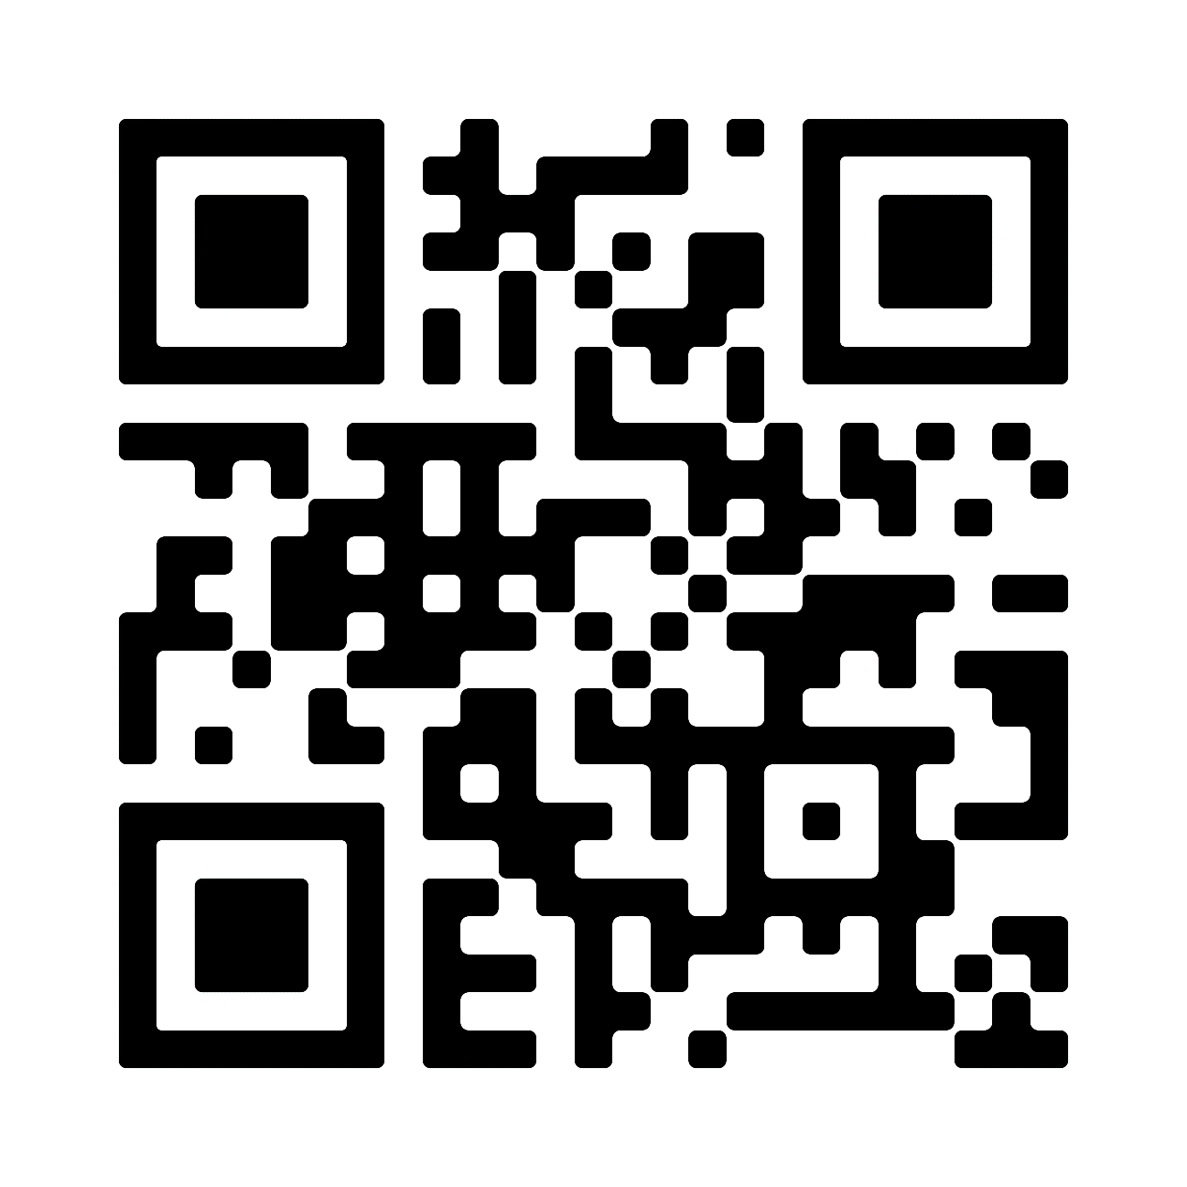

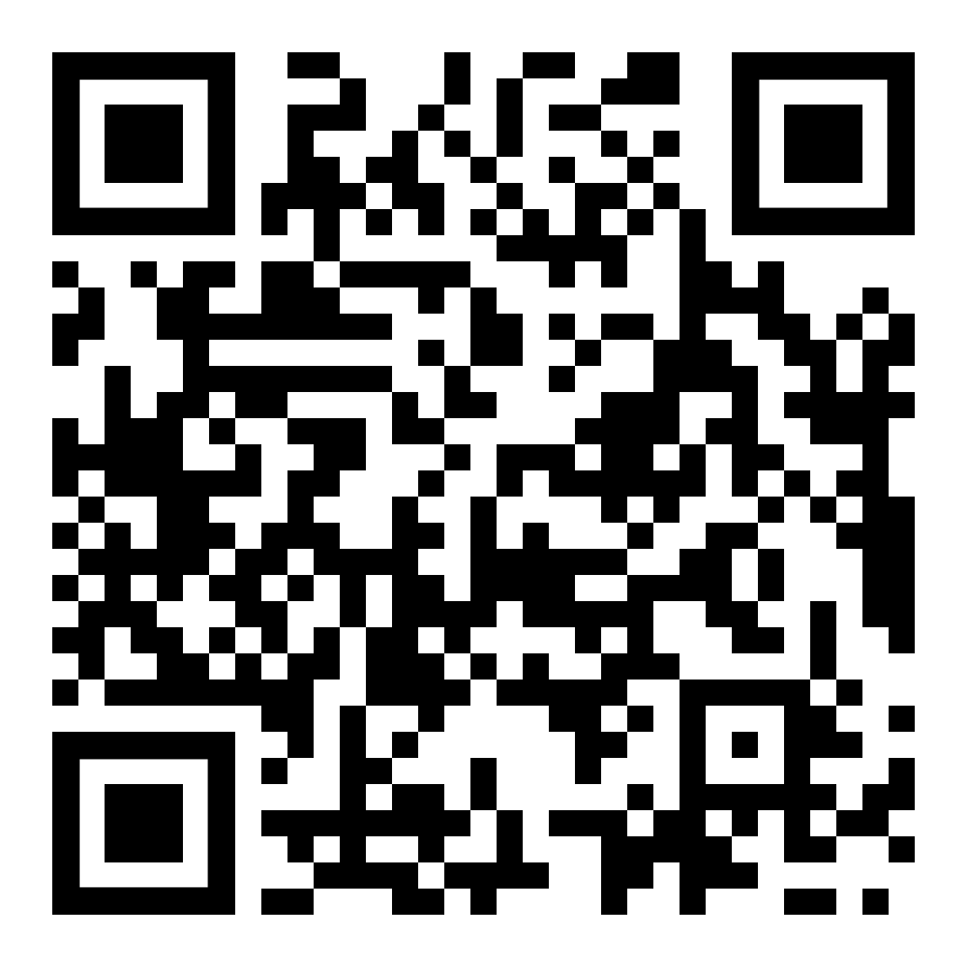
Support
Scout Fundraising
Trail’s End Support
Visit our FAQ page for answers to commonly asked questions & to open a ticket.
Council Support
Contact your District Executive as your first line of support
Dan Hughes at daniel.hughes@scouting.org or (412) 325-7907
Facebook Group
Facebook Group
Join Trail’s End Popcorn Community for best practices, support, news, and answers to questions.

Slide 24
THANK YOU!
Comments and Questions?
Notes:
Thank you again for carving time out of your busy schedules
You are all critical to the future of Scouting and we're honored to play a role in partnering with you to be helpful and supportive

